Slide 1
Lesson 6 – Generics. Collections Framework

Slide 2
Lesson goals
Reuse code via Generics
Built-in containers:
list
distinct-values container
associative array

Slide 3

Before generics
class KfcBucket { private Object content; Object open() { return content; } void pack(Object content) { this.content = content; } }

Slide 4
Before generics
KfcBucket bucket = new KfcBucket(); bucket.pack(new Nuggets());
Object content = box.open() pigeon.eatPotato((Potato) content); // runtime error

Slide 5
Generics
class KfcBucket<T> { private T content; T open() { return content; } void pack(T content) { this.content = content; } }

Slide 6
Generics
KfcBucket<Potato> bucket = new KfcBucket<>();
bucket.pack(new Potato()); bucket.pack(new Nuggets()); // compilation error pigeon.eatPotato(bucket.open()); // unreachable code

Slide 7
Generics
KfcBucket<Potato> potatoBucket = new KfcBucket<>(); potatoBucket.pack(new Potato()); pigeon.eatPotato(potatoBucket.open());
KfcBucket<Nuggets> nuggetsBucket = new KfcBucket<>(); nuggetsBucket.pack(new Nuggets()); cat.eatNuggets(nuggetsBucket.open());

Slide 8
Generics evolution
KfcBucket potatoBucketSinceJava1 = new KfcBucket(); KfcBucket<Potato> potatoBucketSinceJava5 = new KfcBucket<Potato>(); KfcBucket<Potato> potatoBucketSinceJava7 = new KfcBucket<>(); var potatoBucketSinceJava10 = new KfcBucket<Potato>();

Slide 9
Generics usage multiple parameter
class KfcMegaBucket<T, U, V> { private T content1; private U content2; private V content3; void pack(T content1, U content2, V content3) { // ... } T getContent1() { return content1; } U getContent2() { return content2; } V getContent3() { return content3; } }
KfcMegaBucket<Potato, Nuggets, Ketchup> megaBucket = new KfcMegaBucket<>();
megaBucket.pack(new Potato(), new Nuggets(), new Ketchup());

Slide 10
Formal type parameter
■ E - an element
■ K - a map key
■ V - a map value
■ N - number
■ T - a generic data type
■ S, U, V and so forth - for multiple generic types
■ R - return type

Slide 11
Generics bounds. PECS
A bounded parameter type is a generic type that specifies a bound for the generic
Type of bound | Syntax
Fixed bound | type
Upper bound (Produce) | ? extends type
Lower bound (Consume) | ? super type
Unbounded | ?

Slide 12
Generics. Fixed–Bounded
double countFats(KfcBucket<Potato> ... buckets) { double fats = 0.0; for (KfcBucket<Potato> bucket : buckets) { Potato potato = bucket.open(); fats += potato.getFats(); } return fats; }
KfcBucket<Potato> potatoBucket1 = new KfcBucket<>(); potatoBucket1.pack(new Potato()); KfcBucket<Potato> potatoBucket2 = new KfcBucket<>(); potatoBucket2.pack(new Potato());
double fats = countFats(
potatoBucket1, potatoBucket2
);
class KfcBucket<T> { private T content; T open() { return content; } void pack(T content) { this.content = content; } }
abstract class FriedFood { final double fats; FriedFood(double fats) { this.fats = fats; } double getFats() { return fats; } } class Potato extends FriedFood { Potato() { super(14.2); } } class Nuggets extends FriedFood { Nuggets() { super(23.7); } }

Slide 13
Generics. Upper-Bounded Wildcards
double countFats(KfcBucket<? extends FriedFood> ... buckets) { double fats = 0.0; for (KfcBucket<? extends FriedFood> bucket : buckets) { FriedFood friedFood = bucket.open(); fats += friedFood.getFats(); } return fats; }
KfcBucket<Potato> potatoBucket1 = new KfcBucket<>(); potatoBucket1.pack(new Potato()); KfcBucket<Potato> potatoBucket2 = new KfcBucket<>(); potatoBucket2.pack(new Potato()); KfcBucket<Nuggets> nuggetsBucket1 = new KfcBucket<>(); nuggetsBucket1.pack(new Nuggets()); double fats = countFats(
potatoBucket1, potatoBucket2, nuggetsBucket1
);
class KfcBucket<T> { private T content; T open() { return content; } void pack(T content){ this.content = content;} }
abstract class FriedFood { final double fats; FriedFood(double fats) { this.fats = fats; } double getFats() { return fats; } } class Potato extends FriedFood { Potato() { super(14.2); } } class Nuggets extends FriedFood { Nuggets() { super(23.7); } }

Slide 14
Generics. Lower-Bounded Wildcards
void repackToPotato(KfcBucket<? super FriedFood>... buckets) { for (KfcBucket<? super FriedFood> bucket : buckets) { bucket.pack(new Potato()); } }
KfcBucket<Potato> potatoBucket1 = new KfcBucket<>(); potatoBucket1.pack(new Potato()); KfcBucket<Potato> potatoBucket2 = new KfcBucket<>(); potatoBucket2.pack(new Potato()); KfcBucket<Nuggets> nuggetsBucket1 = new KfcBucket<>(); nuggetsBucket1.pack(new Nuggets()); double fats = countFats(
potatoBucket1, potatoBucket2, nuggetsBucket1
);
class KfcBucket<T> { private T content; T open() { return content; } void pack(T content){ this.content = content;} }
abstract class FriedFood { final double fats; FriedFood(double fats) { this.fats = fats; } double getFats() { return fats; } } class Potato extends FriedFood { Potato() { super(14.2); } } class Nuggets extends FriedFood { Nuggets() { super(23.7); } }

Slide 15
Generics. Unbounded Wildcards
void fire(KfcBucket<?> ... buckets) { for (KfcBucket<? > bucket : buckets) { Object content = bucket.open(); System.out.println("Fire: " + content); } }
KfcBucket<Potato> potatoBucket1 = new KfcBucket<>(); potatoBucket1.pack(new Potato()); KfcBucket<Potato> potatoBucket2 = new KfcBucket<>(); potatoBucket2.pack(new Potato()); KfcBucket<Nuggets> nuggetsBucket1 = new KfcBucket<>(); nuggetsBucket1.pack(new Nuggets()); double fats = countFats(
potatoBucket1, potatoBucket2, nuggetsBucket1
);
class KfcBucket<T> { private T content; T open() { return content; } void pack(T content){ this.content = content;} }
abstract class FriedFood { final double fats; FriedFood(double fats) { this.fats = fats; } double getFats() { return fats; } } class Potato extends FriedFood { Potato() { super(14.2); } } class Nuggets extends FriedFood { Nuggets() { super(23.7); } }

Slide 16
Type erasure
// compile time
class KfcBucket<T> { private T content; T open() {
return content; } void pack(T content) { this.content = content; } }
KfcBucket<Potato> potatoBucket = new KfcBucket<>(); potatoBucket.pack(new Potato()); Potato potato = potatoBucket.open();
// compile time
class KfcBucket { private Object content; Object open() {
return content; } void pack(Object content) { this.content = content; } }
KfcBucket potatoBucket = new KfcBucket(); potatoBucket.pack(new Potato()); Potato potato = (Potato) potatoBucket.open();

Slide 17

Collections Framework
Notes:
A collection is a generic term that refers to a container of objects.

Slide 18
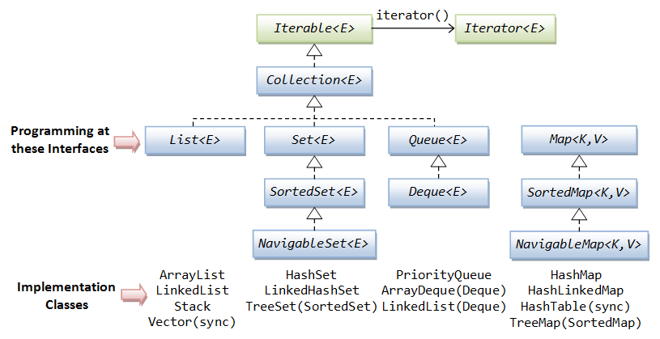
Collections Framework

Slide 19
Iterator vs Iterable
interface Iterator<E> { boolean hasNext(); E next(); void remove();
void forEachRemaining(Consumer<? super E> action); }
interface Iterable<T> { Iterator iterator();
void forEach(Consumer<? super T> action)
Spliterator<T> spliterator()
}

Slide 20
Collection
int size(); boolean isEmpty(); boolean contains(Object o);
boolean containsAll(Collection c);
Iterator<E> iterator(); boolean add(Object e);
boolean addAll(Collection c); boolean remove(Object o);
boolean removeIf(Predicate<? super E> filter)
boolean retainAll(Collection<?> c);
Object[] toArray();
…

Slide 21
List
Can not contain primitives
Kind of auto-resizable array
Ordered
Allows duplicate entries
ArrayList, LinkedList

Slide 22
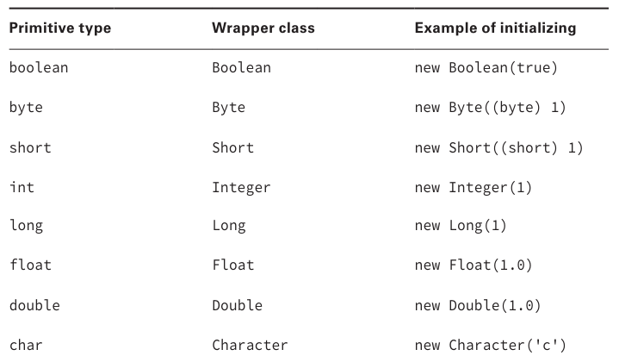
Wrappers

Slide 23
ArrayList
List<String> lessons = new ArrayList<>(); lessons.add("Intro"); lessons.add("OOP"); lessons.add("Collections"); print("All: " + lessons); // [Intro, OOP, Collections] print("Total count: " + lessons.size()); // Total count: 3 print("Last: " + lessons.get(lessons.size() - 1)); // Last: Collections
lessons.remove("OOP"); print("All except removed OOP: " + lessons); // [Intro, Collections]

Slide 24
ArrayList vs array
String[] stringsArray = new String[]{"Intro", "OOP", "Collections"};
List<String> stringsArrayList = new ArrayList<>();
stringsArrayList.add("Intro");
stringsArrayList.add("OOP");
stringsArrayList.add("Collections"); print(stringsArray); // [Ljava.lang.String;@6474c2 print(stringsArrayList); // [Intro, OOP, Collections]
stringsArrayList.remove("OOP");

Slide 25
Generic collections
List names = new ArrayList(); // Java 1+
List<String> names = new ArrayList<String>(); // Java 5+
List<String> names = new ArrayList<>(); // Java 7+
var names = new ArrayList<String>(); // Java 10+

Slide 26
LinkedList
LinkedList<Integer> linkedList = new LinkedList<>(); linkedList.addFirst(2); // 2 linkedList.addLast(3); // 2 3 linkedList.offerFirst(1); // 1 2 3 linkedList.offerLast(4); // 1 2 3 4 linkedList.add(5); // 1 2 3 4 5 linkedList.remove(3); // 1 2 3 5 (remove by index) linkedList.remove(Integer.valueOf(3)); // 1 2 5 (remove by value) linkedList.removeFirst(); // 2 5 linkedList.removeLast(); // 2 linkedList.indexOf(2); // index = 0

Slide 27
Iteration
Collection<Integer> list = List.of(1, 2, 3, 4, 5);
for (int index = 0; index < list.size(); index++) { System.out.println(list.get(index)); }
1
≈2≈3≈4≈5
Iterator iterator = list.iterator(); while (iterator.hasNext()) { System.out.println(iterator.next()); }
for (Integer element: list) { System.out.println(element); }
list.forEach(item -> { System.out.println(item); });
list.forEach(System.out::println);

Slide 28
Set
does not allow duplicates
HashSet, LinkedHashSet, TreeSet, …

Slide 29
HashSet
Backed by HashMap.
Exploits hashCode()method
adding elements takes constant time
existence check takes constant time
supports value ordering TreeSet
lost of insertion order

Slide 30
HashSet
Set<Integer> set = new HashSet<>(); set.add(1); // 1 set.add(2); // 1 2 set.add(1); // 1 2 set.contains(1); // true set.contains(3); // false set.remove(2); // 1

Slide 31
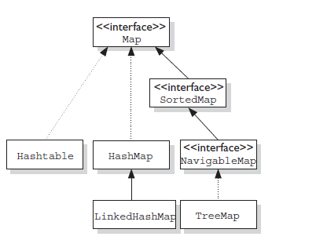
Map

Slide 32
Map
boolean isEmpty() int size()
boolean containsKey(Object key) boolean containsValue(Object) V get(Object key) V put(K key, V value) V remove(Object key) V putIfAbsent(K key, V value) V getOrDefault(Object key, V defaultValue)
void forEach(BiConsumer<? super K, ? super V> action)
Set<K> keySet() Collection<V> values()
…
Notes:
void clear();
merge(), void putAll(Map<? extends K, ? extends V> m)
Set<Map.Entry<K, V>> entrySet()
boolean equals(Object o)
int hashCode()
void replaceAll(BiFunction<? super K, ? super V, ? extends V> function)
boolean replace(K key, V oldValue, V newValue)
V computeIfPresent(K key, BiFunction<? super K, ? super V, ? extends V> remappingFunction)
V computeIfAbsent(K key, Function<? super K, ? extends V> mappingFunction)

Slide 33
Map
HashMap stores the keys in a hash table
adding elements takes constant time
existence check takes constant time
lost of insertion order
TreeMap stores the keys in a sorted tree structure
keys are always in sorted order.
adding and checking if a key is present are both O(log n).
LinkedHashMap…
Notes:
You use a map when you want to identify values by a key

Slide 34
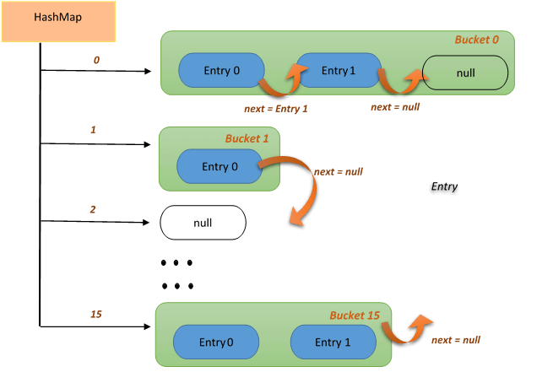
HashMap

Slide 35
HashMap
Map<String, String> map = new HashMap<>(); map.put("koala", "bamboo"); map.put("lion", "meat"); map.put("giraffe", "leaf"); for (Map.Entry<String, String> e : map.entrySet()) { println(e.getKey() + ":" + e.getValue()); // koala:bamboo giraffe:leaf lion:meat } map.forEach((key, value) -> { println(key + ":" + value); // koala:bamboo giraffe:leaf lion:meat });

Slide 36
Coding equals, hashCode and toString
print(1); print("Hello"); print(new Bird("Tweety")); print(new Bird("Tweety").hashCode()); print(new Bird("Tweety").equals(new Bird("Tweety")));
// 1 // Hello // Bird@6474c2 // 6583490 // false

Slide 37
toString
class Bird { String name; public Bird(String name) { this.name = name; } @Override public String toString() { return name; } }
class Main { public static void main(String[] args) { System.out.println(new Bird("Tweety")); // Tweety } }

Slide 38
equals
class Bird { String name; public Bird(String name) { this.name = name; } @Override public boolean equals(Object o) { if (this == o)
return true; if (o == null || getClass() != o.getClass())
return false; Bird bird = (Bird) o; return Objects.equals(name, bird.name); } }

Slide 39
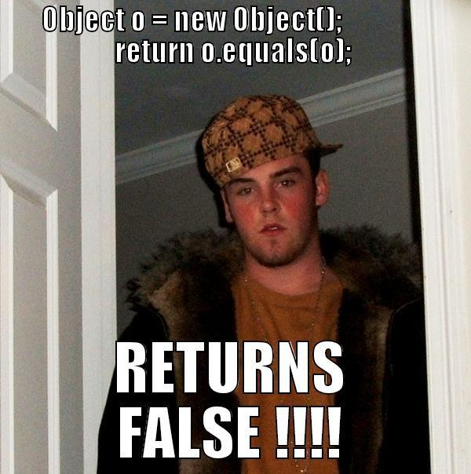
equals

Slide 40
equals - rules
Reflexive: for any non‐null reference value x, x.equals(x) should return true;
Symmetric: for any non‐null reference values x and y, x.equals(y) should return true if and only if y.equals(x) returns true;
Transitive: For any non‐null reference values x, y, and z, if x.equals(y) returns true and y.equals(z) returns true, then x.equals(z) should return true;
Consistent: For any non‐null reference values x and y, multiple invocations of x.equals(y) consistently return true or consistently return false, provided no information used in equals comparisons on the objects is modified;
For any non‐null reference value x, x.equals(null) should return false

Slide 41
equals - what is wrong
@Override
public boolean equals(Bird obj) { if (obj == null) { return false; } return this.name == obj.name; }
Notes:
Compilation fail

Slide 42
equals - what is wrong
@Override
public boolean equals(Bird obj) { if (obj == null) { return false; } return this.name == obj.name; }
Notes:
Compilation fail

Slide 43
hashCode
Whenever you override equals(), you must override hashCode()
Within the same program, the result of hashCode() must not change
If equals() returns true when called with two objects, calling hashCode() on each of those objects must return the same result.
If equals() returns false when called with two objects, calling hashCode() on each of those objects may return the same result.
Notes:
A hash code is a number that puts instances of a class into a finite number of categories.

Slide 44
hashCode
class Bird { String name; public Bird(String name) { this.name = name; } @Override public int hashCode() { return Objects.hash(name); } }

Slide 45
equals, hashCode and toString combination
class Bird { private final String name; public Bird(String name) { this.name = name; } @Override public String toString() { return "Bird{" + "name=" + name + '}'; } @Override public boolean equals(Object o) { if (this == o) { return true; } if (o == null || getClass() != o.getClass()){ return false; } Bird bird = (Bird) o; return Objects.equals(name, bird.name); } @Override public int hashCode() { return Objects.hash(name); } }

Slide 46
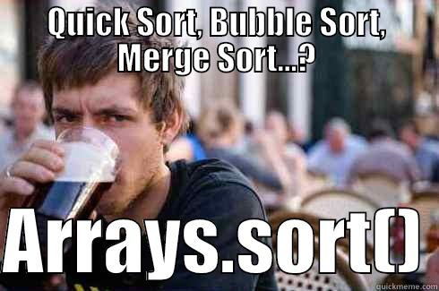
Collections class

Slide 47
Collections class
<T extends Comparable> T max(Collection<? extends T> coll); <T extends Comparable> T min(Collection<? extends T> coll); void reverse(List<?> list); void shuffle(List<?> list); <T> void copy(List<? super T> dest, List<? extends T> src); <T> List<T> synchronizedList(List<T> list); <T extends Comparable<? super T>> void sort(List<T> list); <T> void sort(List<T> list, Comparator<? super T> c);
<T extends Comparable> int binarySearch(List<? extends Comparable<? super T>> list, T key);

Slide 48
Comparable
class Animal { String name; Integer strength; // constructor
}
List<Animal> animals = new ArrayList<>(); animals.add(new Animal("cat", 3)); animals.add(new Animal("dog", 2)); animals.add(new Animal("elephant", 45));
Collections.sort(animals); // fails to compile
for (Animal animal : animals) { println(animal.getname()); }

Slide 49
Comparable
public interface Comparable<T> { int compareTo(T o); }
Zero is returned when the current object is equal to the argument to compareTo().
A number less than zero is returned when the current object is smaller than the argument to compareTo().
A number greater than zero is returned when the current object is larger than the argument to compareTo()

Slide 50
Comparable
class Animal implements Comparable<Animal> { String name; Integer strength; // constructor @Override public int compareTo(Animal other){ return name.compareTo(other.name); } }
List<Animal> animals = new ArrayList<>(); animals.add(new Animal("cat", 3)); animals.add(new Animal("dog", 2)); animals.add(new Animal("elephant", 45));
Collections.sort(animals);
animals.forEach(System.out::print); // cat dog elephant

Slide 51
Comparator
public interface Comparator<T> { int compare(T o1, T o2); }
Zero is returned when the arguments of compare() methods are equal.
A number less than zero is returned when the first argument is smaller than the second argument to compare()
A number greater than zero is returned when the first argument is greater than the second argument to compare()

Slide 52
Comparator
class Animal { String name; Integer strength; // constructor }
Comparator<Animal> animalComparatorByStrength = new Comparator<>() { @Override public int compare(Animal o1, Animal o2) { return o1.strength.compareTo(o2.strength); } }
List<Animal> animals = new ArrayList<>(); animals.add(new Animal("cat", 3)); animals.add(new Animal("dog", 2)); animals.add(new Animal("elephant", 45));
Collections.sort(animals, animalComparatorByStrength);
animals.forEach(System.out::print); // dog cat elephant

Slide 53
Homework
Adapt StudentsRegistry to exploit a full power of generics and collections framework instead of plain arrays for operations like reading, sorting, grouping.
Find the fastest implementations across:
ArrayList vs LinkedList: get/add/remove/set values in the beginning/middle/end;
HashSet vs LinkedHashSet vs TreeSet: add/remove/contains values in non-empty;
HashMap vs LinkedHashMap vs TreeMap: add/removal/update/contains in non-empty;
Sock-merchant problem from HackerRank

Slide 54
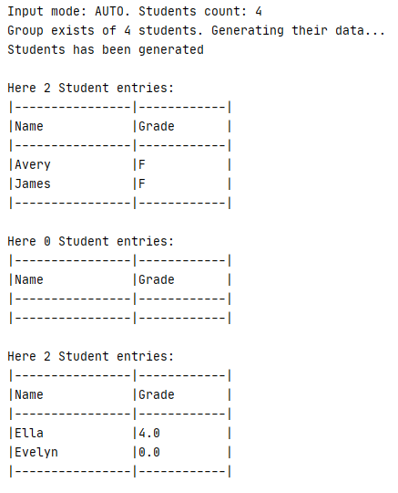
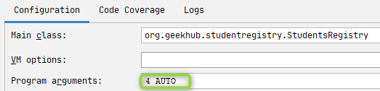
Homework
Add support of input modes of students list. MANUAL and RANDOM. Input mode should be passed as a second command line argument. When argument is invalid – return error. If correct value is specified – generate random students instead of manual input and run the main flow. See java.util.Random class

Slide 55
To read
“Clean Code: A Handbook of Agile Software Craftsmanship” by Robert C. Martin : Chapter 10-12
“Java: The Complete Reference” by Herbert Schildt (chapter 14, 19)
Generics
Collections
Cheat sheet

Slide 56
Thanks!
Any Questions?
Or find us in Slack:
@Yaroslav Brahinets
@Vasya Rudas

